Slide 1
How can we celebrate significant, local people and places: Cary Grant
How can we celebrate significant, local people and places: Cary Grant, 50 Berkeley Road, Bishopston, Bristol.
Notes:
Image: Cary Grant - RKO publicity still from Suspicion (1941). Wikimedia commons –https://commons.wikimedia.org/wiki/File:Grant,_Cary_(Suspicion)_01.jpg

Slide 2
How can we celebrate significant, local people and places: Cary Grant (Archie Leach), 50 Berkeley Road, Bristol.
Key Stage 2
To learn about significant historical events, people and places in their own locality
To study an aspect of history dating from a period beyond 1066 that is significant in the locality
To understand historical concepts such as significance, and to make connections and draw contrasts with previous learning
To understand the methods of historical enquiry, including how evidence is used rigorously to make historical claims

Slide 3
How to use this PPT
Contents:
Pupils will start by thinking about criteria we can use to decide if someone is significant.
They will then use a building to start their enquiry in to Cary Grant, building on this with a range of additional historical sources to help them answer the question: What makes Cary Grant a significant person?
As a final task they will design their own plaques to Cary Grant.
What makes a person significant?
How can we find out about local significant people?
What can a building tell us?
Meet Cary Grant
Using old maps & aerial photos
Cary’s acting career
What makes Cary Grant a significant person?
A Blue Plaque for Cary Grant
Task – Design a Blue Plaque

Slide 4
What makes a person significant?
Questions to ask about a person.
Did they:
make big changes in their lifetime?
make a lot of people’s lives better or worse?
change the way people think about something?
have a lasting impact on their locality, the country or the world?
set a really good/bad example to people about how to live and behave?
Notes:
For this activity we’re using Ian ‘Dawson’s Model’ for significance criteria.

Slide 5
How can we find out about locally significant people?
?
Ask people who might know about them
Use books and the internet to research them
Find buildings and places connected to them
Who’s local to me?

Slide 6
50 Berkeley Road, Bristol 1
Investigate
This is 50 Berkeley Road in Bishopston, Bristol.
It is connected to Cary Grant; our local, significant person.
Find Berkeley Road on Google Maps.
How many miles away is it from your school?
How long would it take you to walk or drive?
Would you say this building is local to your school?
Notes:
Image: 50 Berkeley Road, Bristol. © Historic England

Slide 7
What can a building tell us?
History detectives!
Complete the inference grid on the next page to explore what this building can tell you…..

Slide 8
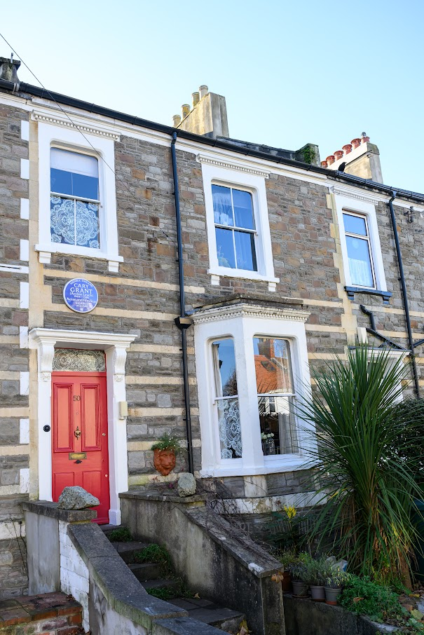
What can this building tell us?
(I think….because)
Notes:
Image: 50 Berkeley Road, Bristol. © Historic England

Slide 9
What can this building tell us?
What questions do you want to ask?
What can you infer? (I think…because…)
What can you see?
Notes:
Image: 50 Berkeley Road, Bristol. © Historic England

Slide 10
50 Berkeley Road, Bristol 2
50 Berkeley Road looks like an ordinary terraced house, on an ordinary street in Bristol.
But it is actually very special….
Terraced House - One of a row of three or more houses joined together.
Notes:
Image: 50 Berkeley Road, Bristol. © Historic England

Slide 11
Meet Cary grant1
The man in the picture is called Cary Grant.
As part of this enquiry, we’ll find out what he did and why he might be considered to be a significant person.
Notes:
Image: © Bristol Live/BPM MEDIA - Photo by Alan Grifee (c) Bristol Post

Slide 12
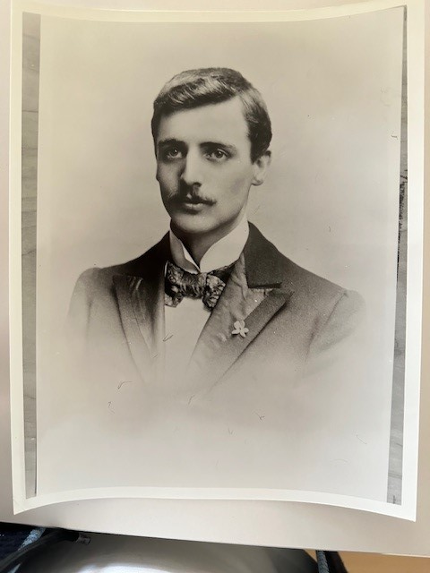
Cary Grant
Elias James Leach
Cary Grant was born on 18th January 1904 in Bristol.
His real name was Archibald Alec Leach, he was the second son of Elias and Elsie Leach
His father worked as a clothes presser.
Sadly, Archie’s older brother John died before Archie was born.
Elsie Leach
Notes:
Image 1: Photograph of Elias James Leach, Cary Grant's father. Courtesy Estate of Cary Grant.
Image 2: Cary Grant's mother, Elsie Leach, date unknown. Courtesy Estate of Cary Grant.

Slide 13
Meet Cary Grant
Archie had a difficult childhood as his parents did not have much money.
He lived at 6 different addresses in his childhood in Bristol
His happiest childhood memories were of 50 Berkeley Road. He recalled having a swing at the bottom of the garden.
Archie Leach (Cary Grant)
Notes:
Image: Cary Grant (Archibald Leach) c.1908, age c. 4 years old, when he was living at 50 Berkeley Road Bristol. Courtesy Estate of Cary Grant

Slide 14
50 Berkeley Road, Bishopston Bristol
50 Berkeley Road was a childhood home of Cary Grant, or as he was known then, Archie Leach.
He lived there from 1906 when he was 2 until the age of 6 in 1910. From the age of 4, Archie attended nearby Bishop Road Primary School, a 5 minute walk away.
Have you heard of Cary Grant?
Have you seen any of his films?
50 Berkeley Road, Bristol
Notes:
Image: Source: Historic England Archive (Authorised use only) Ref: raf_

Slide 15
50 Berkeley Road – 1903
Archie and his family moved to 50 Berkeley Road shortly after this map was made.
Can you use the map on the next slide to work out a route that he might have used to walk to school?
You could even write a set of directions for someone to follow.
Is there more than one way?
Could you still follow the same route today?
50 Berkeley Road, Bristol
Notes:
Image: Source: Historic England Archive (Authorised use only) Ref: raf_

Slide 16
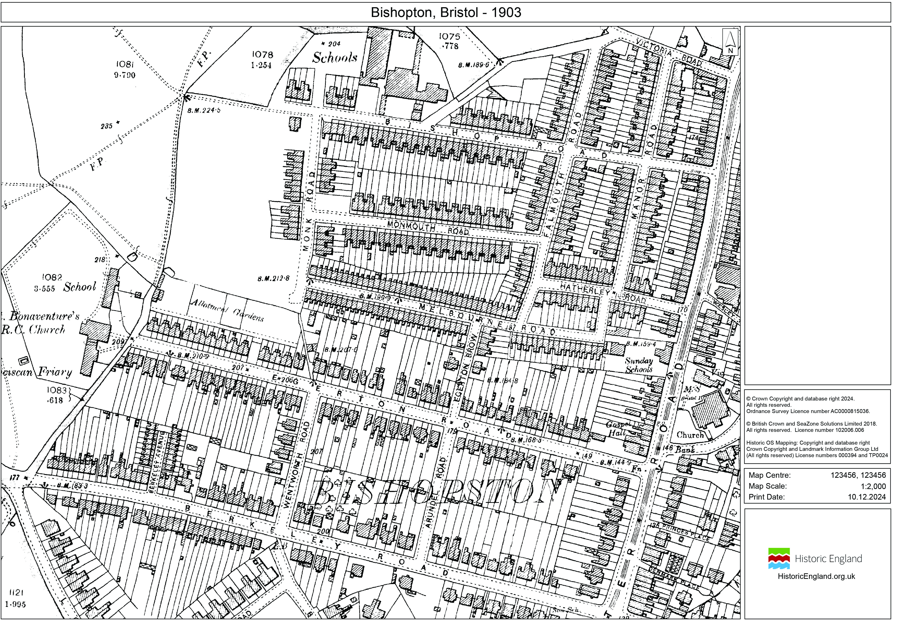
What route could Archie take?

Slide 17
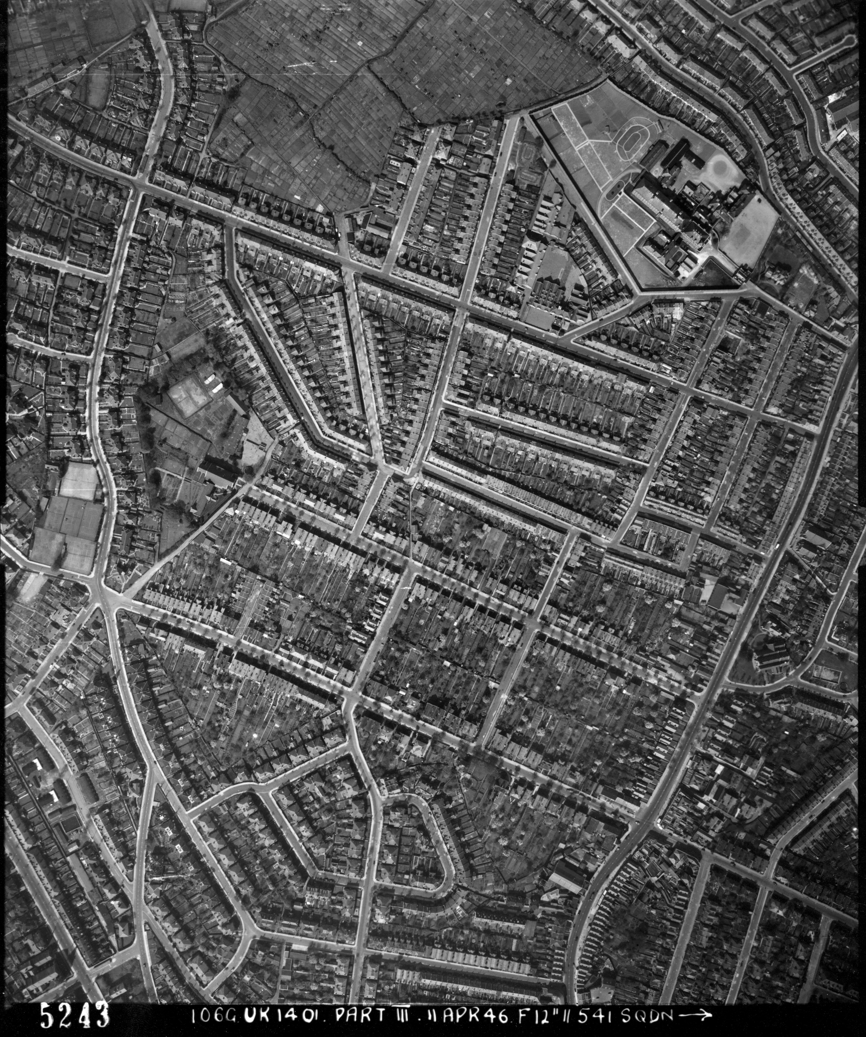
What differences can you spot between the 1903 map and 1946 aerial photo?

Slide 18
What differences did you spot between the 1903 map and 1946 aerial photo?

Slide 19
Everything to the left of the yellow line is new. Lots more houses have been built.

Slide 20
Bishop Road School
Here is Archie at Bishop Road School in Bishopston aged about 5 or 6.
He later went to Fairfield Secondary School in Montpelier in Bristol.
As a child, he always dreamed of a life of adventure on the stage.
Archie Leach (Cary Grant)
Notes:
Image: Bishops Road Primary school, Class 2. Date unknown. School photo featuring Cary Grant (Archibald Leach). Thought to be in the photograph, possibly at the back in the middle of the left most wall.

Slide 21
The Bristol Hippodrome
When at Fairfield Secondary School, Archie got a job working on the lighting at Bristol Hippodrome.
He was immediately bedazzled by the company and cheeriness of theatre life.
When he was 14, he ran away from home and joined a company of acrobats.
The auditorium, Bristol Hippodrome
Notes:
Image: © Historic England Archive Ref: NWC01/01/1516 - https://historicengland.org.uk/images-books/photos/item/NWC01/01/1516

Slide 22
Penders Acrobatic Troupe
Archie toured with the troupe all over Britain.
When he was 16 he travelled with the company by ship to America.
He stayed in America and started getting parts as a stage actor.
Penders Acrobatic Troupe
Notes:
Image: Penders Acrobatic Troupe on stilts. The whole troupe on stage, probably in Liverpool. Olive Hart (nee Watts) presenting, John Henry Hart on tallest stilts. Archie Leach (later known as Cary Grant) played second from left. Image source: https://quarlton.co.uk/ - © 2024 The home of Dave and Ruth Simpson

Slide 23
Hollywood
In 1930 he changed his name to Cary Grant and travelled to Hollywood.
His natural good looks and charm meant that he soon became a star of the silver screen.
From the 1930s to the 1960s Cary Grant was one of the most famous Hollywood film stars appearing in over 100 movies.
Cary Grant in North by Northwest 1959
Notes:
Image: Photo of Cary Grant from the film North by Northwest (1959). Metro-Goldwyn-Mayer, Public domain https://commons.wikimedia.org/wiki/File:Cary_Grant_North_by_Northwest_still.jpg?uselang=uk

Slide 24
Cary Grant and Bristol
In later life, Cary Grant regularly returned to Bristol to visit his mother Elsie.
He always enjoyed a meal of fish and chips in Bristol.
Cary Grant in Bristol
Notes:
Image: © Bristol Live/BPM MEDIA - Cary Grant at Avon Gorge Hotel, looking towards Bristol's Clifton Suspension Bridge.

Slide 25
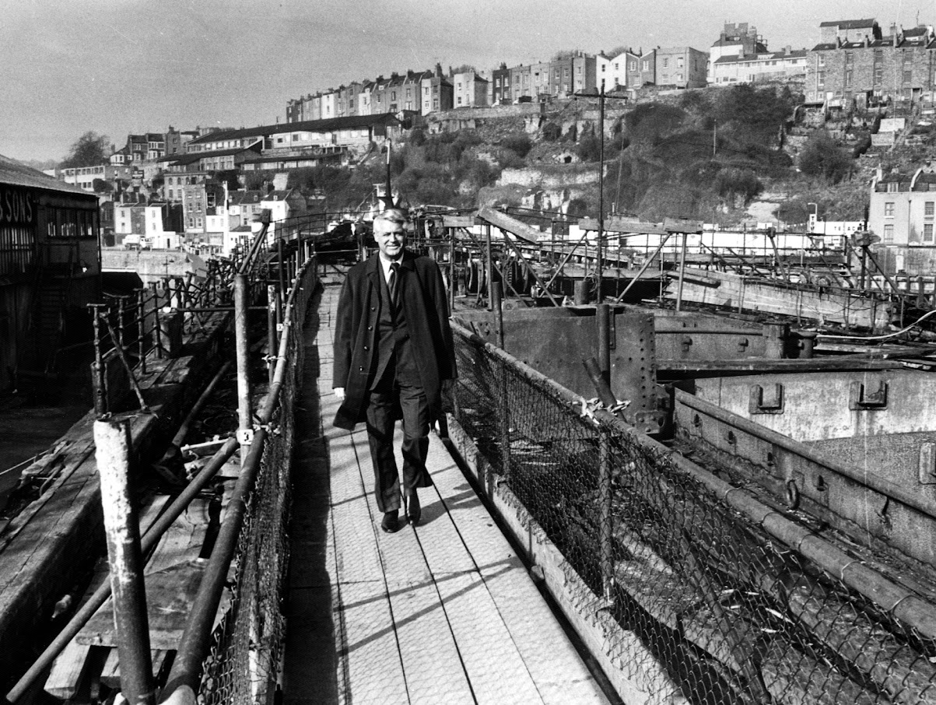
What makes Cary Grant a significant person?
Watch this clip about Cary Grant’s film career .
How would you describe it?
He was a film actor who was popular all over the world
He has been described as ‘the greatest leading man Hollywood has ever known’
He was nominated for two Oscars during his career
He overcame an impoverished upbringing to lead a great and successful life
He never forgot his roots in Bristol
Notes:
Clip about Cary Grant: https://www.bbc.co.uk/iplayer/episode/p0b4gqx0/inside-cinema-shorts-80-cary-grant
Image: © Bristol Live/BPM MEDIA - Cary Grant at Bristol Harbour

Slide 26
How do we remember and celebrate significant people?

Slide 27
A national blue plaque to Cary Grant
Cary’s plaque
We have learnt all about why Cary Grant, and 50 Berkeley Road, are historically significant. To mark and celebrate Cary Grant and his birthplace, on 22nd November 2024, a national blue plaque was placed on the wall outside 50 Berkeley Road.
What is a national blue plaque?
National blue plaques are placed on buildings connected to significant people. Until 2024 there was an “official” blue plaque scheme, which ran in London. Local councils and organisations also ran their own schemes. In February 2024, Historic England took responsibility for a national blue plaque scheme. Their plan is to place blue plaques across the country to celebrate “people throughout history who have made significant and positive contributions to human welfare or happiness.”
Cary in 1941
Notes:
Image 1: Blue Plaue. © Historic England
Image 2: Cary Grant - RKO publicity still from Suspicion (1941). Wikimedia commons –https://commons.wikimedia.org/wiki/File:Grant,_Cary_(Suspicion)_01.jpg

Slide 28
Why 50 Berkeley Road?2
The national blue plaque on the external wall of 50 Berkeley Road is only the fourth blue plaque to be placed as part of Historic England’s new scheme!
Historic England say that national blue plaques should be placed on buildings that “have had a significant influence in forming a person’s character or shaping their activities”.
Think
Why might you say that 50 Berkeley Road meets that description?
Notes:
Image: 50 Berkeley Road, Bristol. © Historic England

Slide 29
Archie Leach / Cary Grant
The young Archie Leach was able to follow his dreams and become a Hollywood star.
What are your hopes and dreams for your future?
Archie Leach in Class 1 at Bishop Road Primary
Notes:
Image: 'Bishops Road Primary School Class 1' - School photo featuring Archibald Leach (Cary Grant). Thought to be back row, fourth from right. Courtesy Estate of Cary Grant.

Slide 30
Your Task – Part 1
On the template you have been given, design your own plaque celebrating why Cary Grant is such a significant person. Make sure you….
Cary
Grant
1904 - 1986
Complete the sentence:
Cary Grant is significant because….
You might like to write one or a couple of sentences.
Write

Slide 31
Your Task – Part 2
Draw a picture to illustrate your plaque.
You might like to draw the inside or outside of Berkeley Road, using the descriptions from the previous slides for inspiration!
Cary
Grant
1904 - 1986
Draw

Slide 32
George Harrison Plaque
Cary
Grant
1904 - 1986

